Slide 1
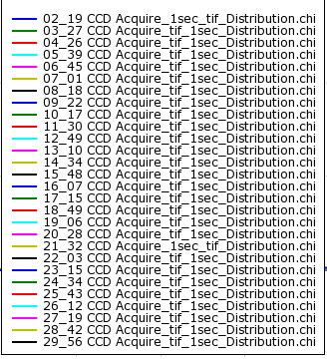

YR3-ePDF Analysis
OBSIDIAN SURFACE
2
29 analysis points
from
surface to 8 micron deep
29
Each distance has 0.275 microns approximately
Only the first Si-O 1.6 Å, 2.4 Å ?, O- O 2.7 Å and Si-Si 3.2 Å distances are distinguishable in all SiO2 polymorphs

Slide 2
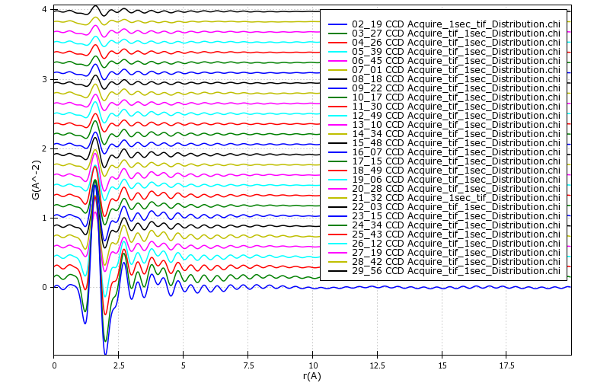
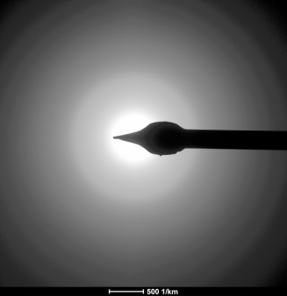
YR3-ePDF Analysis from 29 different locations
Si-O 1.6 Å
O- O 2.7 Å
Only the first Si-O 1.6 Å, 2.4 Å ?, O- O 2.7 Å and Si-Si 3.2 Å distances are distinguishable in all SiO2 polymorphs
First Peak position (red line) Stay in the sample Place
Second Peak position (blue line) have small systematic shift once we go from 2 to 29

Slide 3
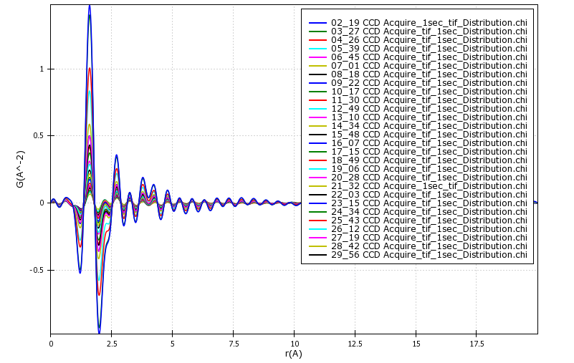
YR3-ePDF Analysis
Si-O
O-O
?
Coordination number variation of Si-O, O-O, Si-Si PDF peaks are roughly equivalent to their peak height ; this varies with distance from surface, reveals possible true variation of hydration layer from surface of the sample
Only the first Si-O 1.6 Å, 2.4 Å ?, O- O 2.7 Å and Si-Si 3.2 Å distances are distinguishable in all SiO2 polymorphs
Height of the first Peak (red arrow) drops once we go from 2 to 29
Height of the second peak (green arrow) increases once we go from 2 to 29
Height of the third Peak (blue arrow) increases once we go from 2 to 29

Slide 4
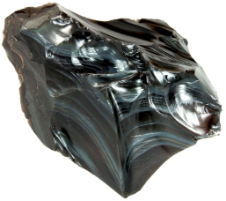
e-PDF Peak height evolution (coordination number) with depth
Coordination number variation of Si-O with distance from surface, reveals possible true variation of hydration layer from surface of the sample
Si-O coordination number
O-O coordination number
Only the first Si-O 1.6 Å, 2.4 Å ?, O- O 2.7 Å and Si-Si 3.2 Å distances are distinguishable in all SiO2 polymorphs
Each distance has 0.275 microns approximately
Si-O coordination number
Si-Si coordination number

Slide 5
First inflection point (red arrow at 1,65 μ)
Saturation layer ?
End hydration layer (blue arrow)
blue arrow 4,12 μ
Number 6 : 1,65 μ
Number 15 : 4,12 μ
Number 13: 3.57 μ
12.000 YEARS OF HISTORY ?

